Slide 1
Digital Watermarking
Group 8

Slide 2
Topics
Introduction to Digital Watermarking
Classification of Watermarks
Applications of Digital Watermarking
Techniques
Watermarking of Grayscale images
  Concepts and Implementation
  Simulation and results
Conclusion
Plan for the future

Slide 3
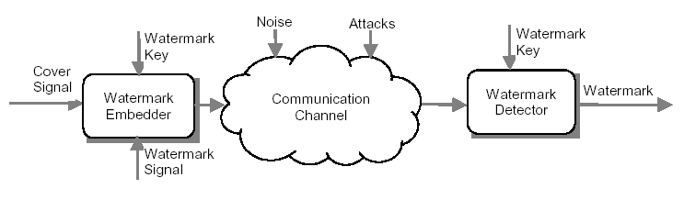
Introduction
Digital watermarking
Features
  Imperceptibility
  Robustness
  Inseparability
  Security

Slide 4
Classification
Digital
Watermarks
Robust
And
Fragile
Watermarking
Visible
And
Transparent
Watermarking
Public
And
Private
Watermarking
Asymmetric
And
Symmetric
Watermarking
Steganographic
And
Non-
Steganographic
Watermarking

Slide 5
Applications
Copyright Protection
Tracking
Tamper Proofing
Broadcast Monitoring
Concealed Communication

Slide 6
Techniques
Spatial Domain
Transform Domain
  Discrete Fourier Transform (DFT)
  Discrete Cosine Transform (DCT)
  Haar Transform
  Discrete Wavelet Transform (DWT)

Slide 7
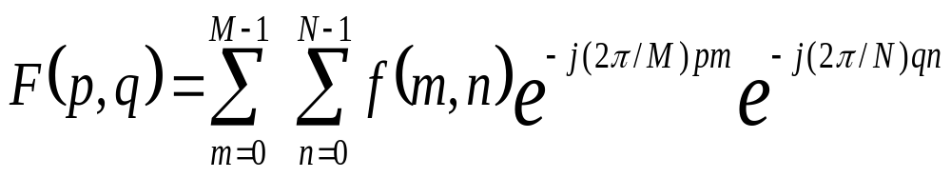
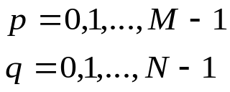
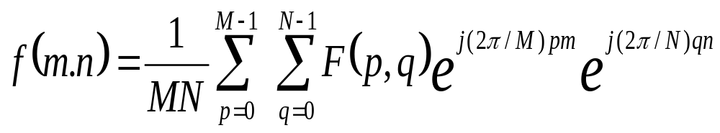
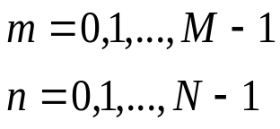
Transform Domain Techniques
Discrete Fourier Transform (DFT)

Slide 8
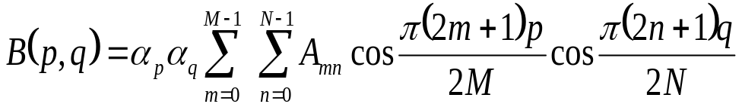
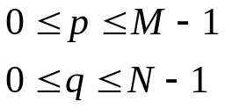
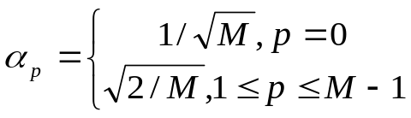
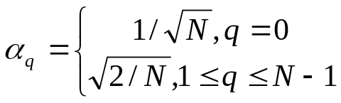
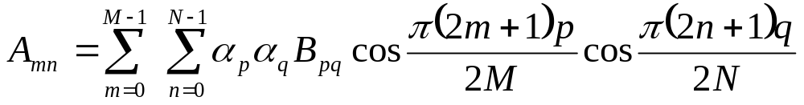
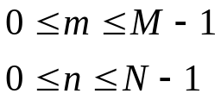
Transform Domain Techniques
Discrete Cosine Transform
  Forward DCT
  Inverse DCT

Slide 9
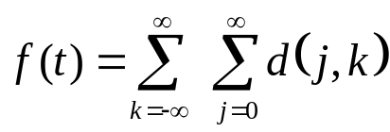
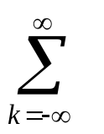
Transform Domain Techniques
Haar Transform
ψ(2^{j}t-k) +
c_{k}φ(t-k)
φ(t) = 1, 0<=t<1,
= 0, otherwise
ψ(t) = 1, 0<=t<0.5,
= -1, 0.5<t<1
1
1
1
1
φ(t)
ψ(t)
ψ(4t-k)
Figure :The Haar Basis Scale and Wavelet Functions

Slide 10
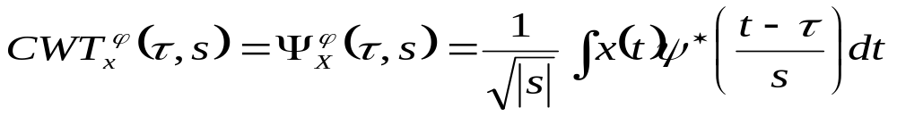
Transform Domain Techniques
Discrete Wavelet Transform (DWT)
  Continuous Wavelet Transform (CWT)
  Inverse CWT
ψ(ω) =∫ ψ(t) e -iωt dt
f(t)= 1/C [∫ ∫ [(1/ ⎢a ⎢2 W(a,b) ]1/√ ⎢a ⎢)ψ*((t-b)/a)] da db
C =∫ ⎜ψ(t) ⎜2/ ⎜ω⎜ dω

Slide 11
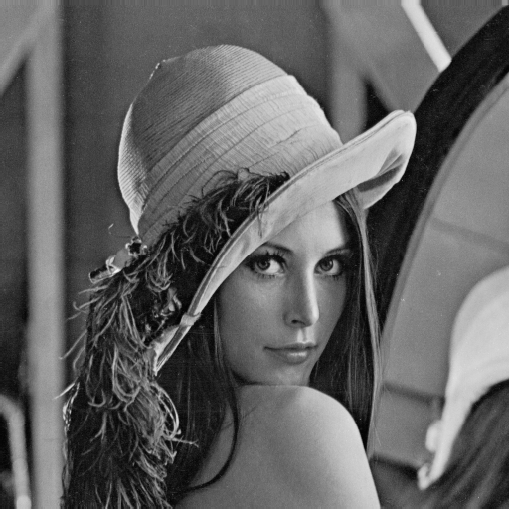
Watermarking Concept
Cover image is standard grayscale Lena image of size 512x512 pixels
Watermark is a bi-level image of size 16x16 pixels.
Obtain the DCT of the cover signal.
Convert bi-level watermark data into polar form.
Divide the transformed cover signal into blocks of size 8x8.
Select middle coefficients from each 8x8 block for modification as per formula
64 * (M1*M2) /(N1*N2)
Cover Signal
Watermark

Slide 12
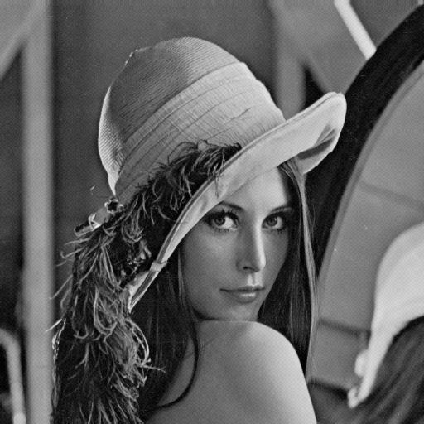
Watermarking Concept
+
α
=
*
Coverimage(i,j) + watermark(x,y) * α = WatermarkedImage(i,j)

Slide 13
Implementation
Step 1: The cover image is divided into 16 blocks each of size128x128 pixels.
Step 2: One copy of the watermark is embedded in each of the blocks.
Step 3:
No. of coeffs=64*(16*16)/(128*128)
=1
Step 4: The polar watermark matrix of size 16x16 is mapped into a 128x128 matrix.
Step 5: This expanded matrix is then used to watermark each block of the cover image.
Step 6: Depending on the polarity of the watermark pixel, we add or subtract a scaling factor α
Step 7: Take the inverse DCT of this modified matrix to get the watermarked image.

Slide 14
Extraction
Step 1: Take the DCT of both the original and watermarked image.
DifferenceImage = WatermarkedImage – OriginalImage
Step 3: Take the first 128x128 portion of this difference image and convert this bipolar matrix into a unipolar one
Step 4: Map this new matrix of size 128x128 down to a 16x16 matrix to obtain the binary watermark.

Slide 15
Results
Extracted Watermark (enlarged)
Watermarked image for α = 0.1

Slide 16
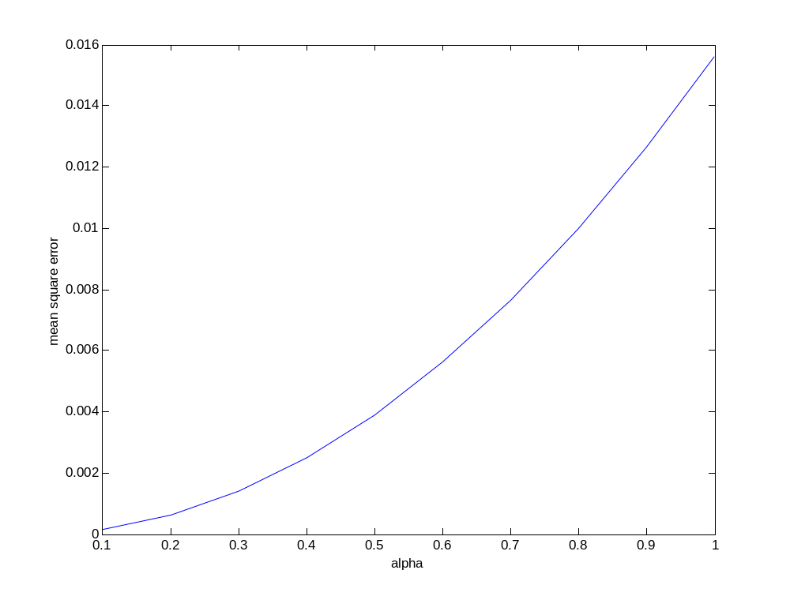
Figure: Graph of α vs. mean square error

Slide 17
Second implementation
Step 1: The original image I, and digital watermark W are represented as
Z={z (i, j), 0<=i<N1, 0<=j<N2}
where, z( i, j)∈{0,…,2L-1} is the intensity of pixel z( i, j) and L is the number of bits used in each pixel.
W={w (i, j), 0<=i<M1, 0<=j<M2}
where w(i, j)∈{0, 1}
Step 2: Pseudorandom Permutation of the Watermark Wp=Permute (W)
Step 3: Block Transformation of the Image
Y=FDCT (Z)

Slide 18
Second implementation
Step 4: Choice of Middle-Frequency Coefficients
Yr = Reduce (Y)
Step 5: Modification of the DCT Coefficients
O=Polarity (Yr)
Ŏ =XOR (O, Wp)
Ŷr=Expand (Ŏ)
Step 6: Inverse Block Transform
Ž=IDCT (Ŷ)

Slide 19
Extraction
Step 1: Block Transformation
Y=FDCT (Z) Ŷ=FDCT (Ž)
Step 2: Generation of Polarity Patterns
Yr = Reduce (Y)
Ŷr = Reduce (Ŷ) Ŏ =Polarity (Yr) Ŏ = Polarity (Ŷ)
Step 3: Extract the Permuted Data
Ŵp =XOR (O, Ŏ )
Step 4: Reverse Pseudorandom Permutation

